Slide 1
The Dustpad
Quantifying Dust

Slide 2

Why the dustpad?
Using data to keep track of cleanliness to improve our lives.
I’m allergic to dust…

Slide 3
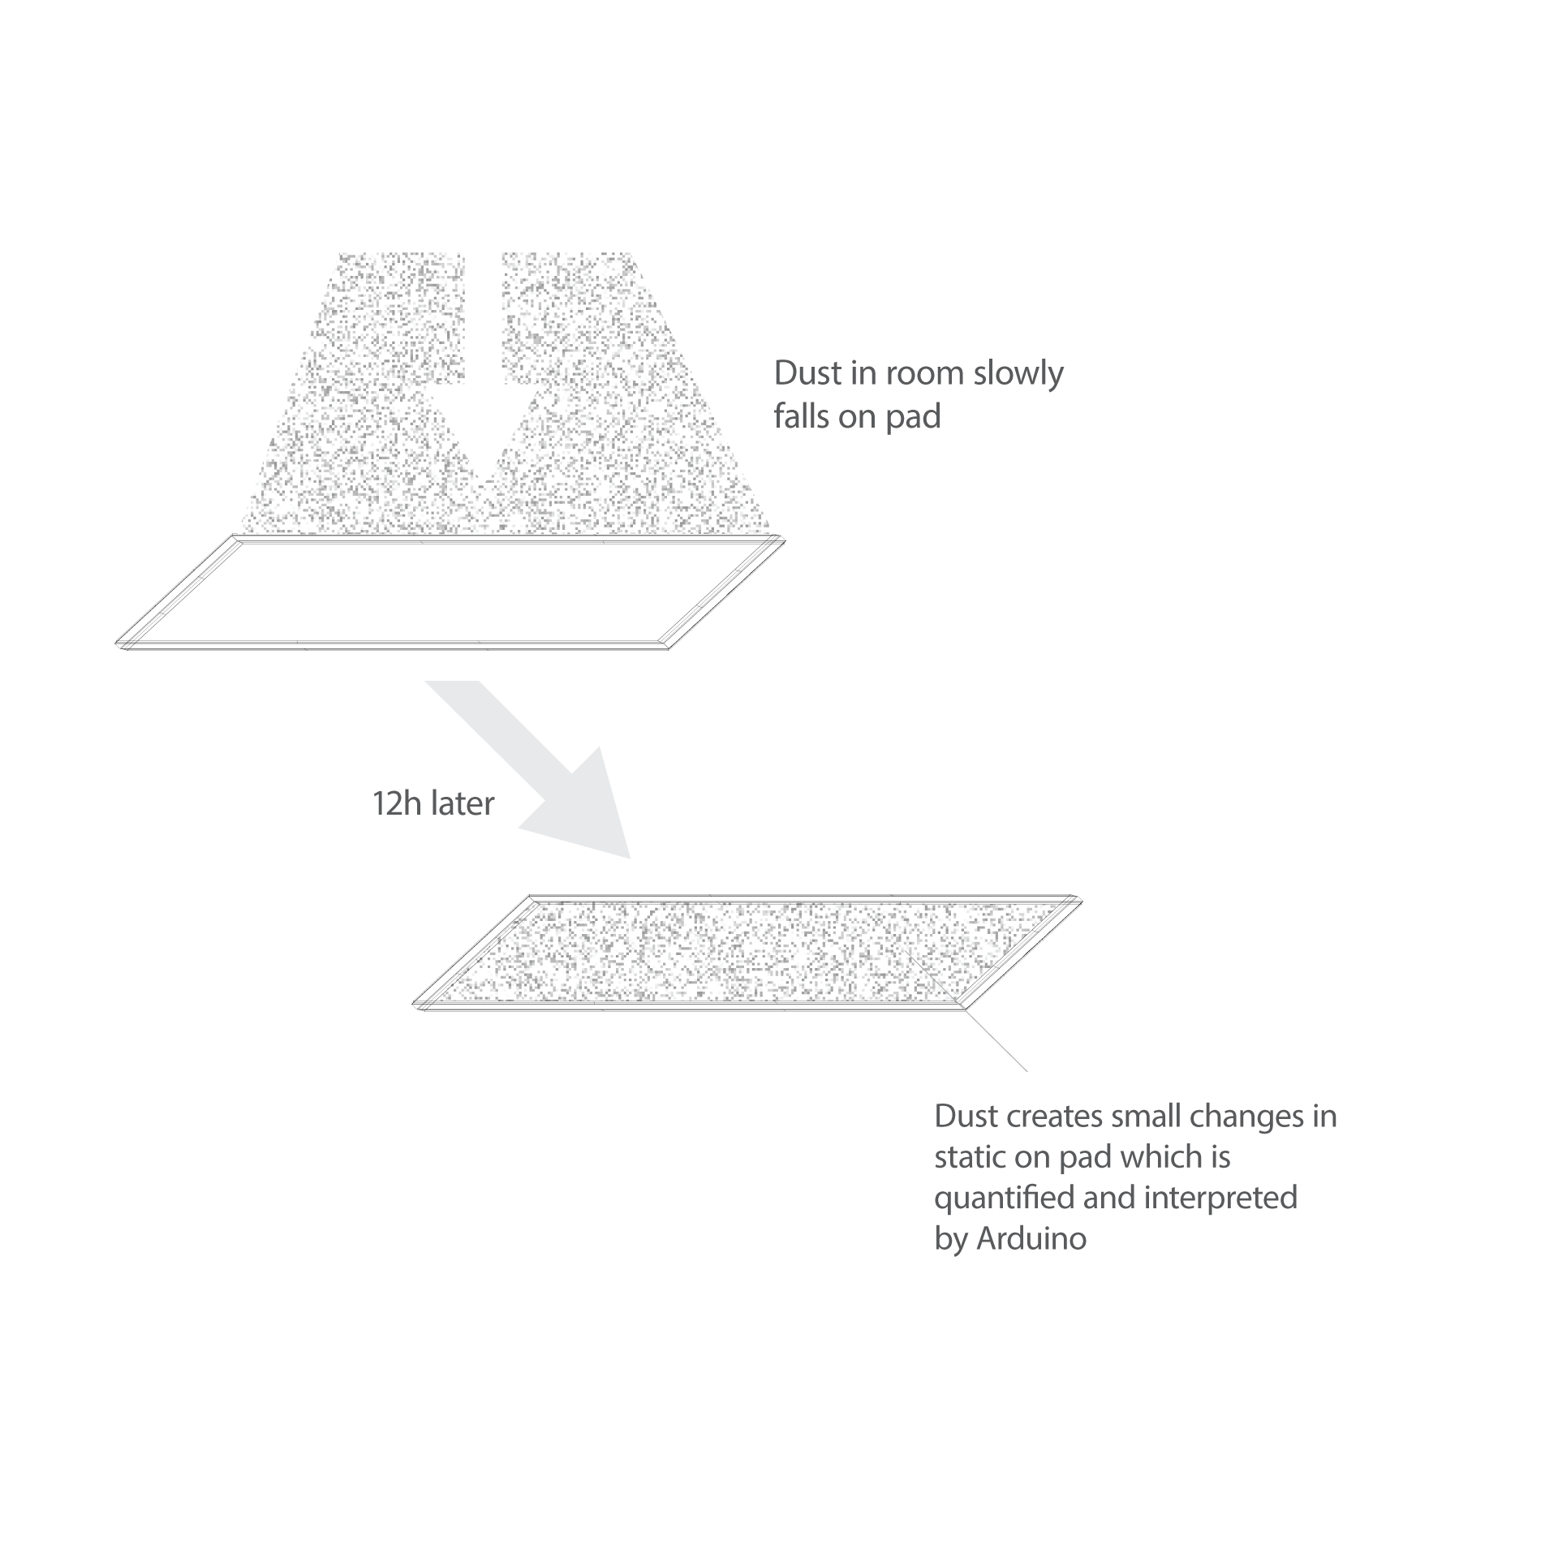

Slide 4
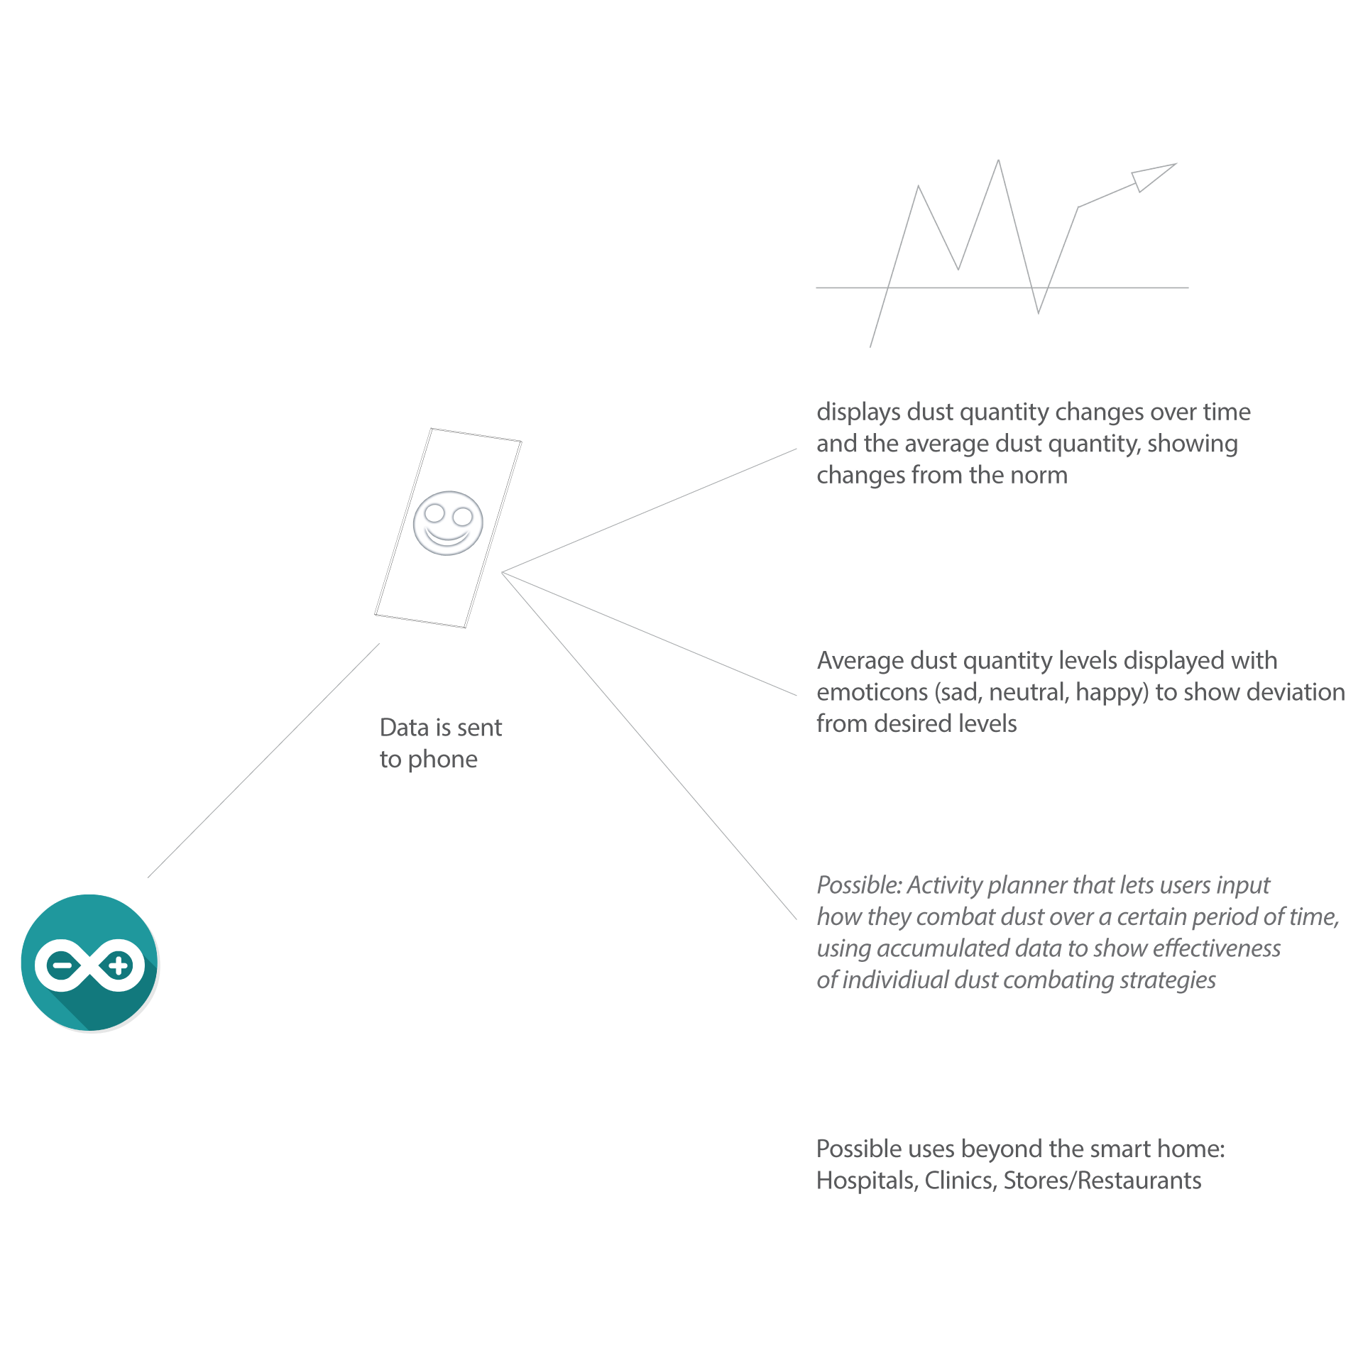

Slide 5
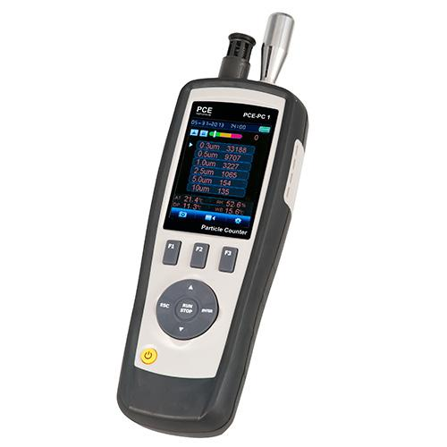
Current devices
Problems:
No open source solution
Expensive
Non automated handheld design

Slide 6
Possible Solutions
Charting new ground?
Scan dust accumulation over time and send photos to Arduino to quantify dust accumulation
Challenge:
This would be too much of a coding challenge.
Quantification would need dust speck recognitioning system
This application may work in theory, but is too big of a design challenge because it would require machine recognition

Slide 7
The simplest solution?
Scan accumulated dust,
Send pictures to Arduino
And let users see a slideshow of dust accumulation over time
For the prototype’s purpose this may be in the timespan of a couple of hours to see the immediate changes, whereas the real-world use case would be over days/months
Forfeit the dust application for now. Community angle also forfeited. (e.g. no dust accumulation averages sent from different devices)
The nagging question:
But can we even scan dust effectively?

Slide 8
This barebones solution would be only a hint at the possible usefulness of the final application
It could still raise awareness on the concept of becoming more pro-active in using data to manage cleanliness

